Slide 1


Slide 2

Asynchronous Programming in .NET: Then and Now

Slide 3
William Austin consultant, sdg @wyldebill William.austin@solutiondesign.com solutiondesign.com

Slide 4

Asynchronous background
Threads/ThreadPool
Asynchronous Programming Model (APM)
Event-Based Asynchronous Pattern (EAP)
Task /Task-Based Asynchronous Pattern (TAP)

Slide 5
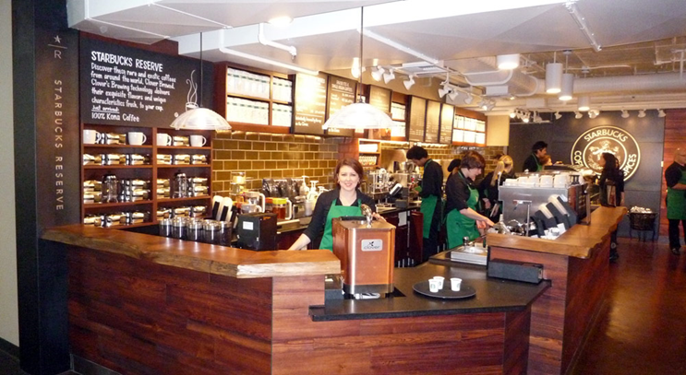
No waiting at the register.
Notes:
Asynchronous
Initiate something here and now.
I’ll regain control to execute something else “immediately”.

Slide 6
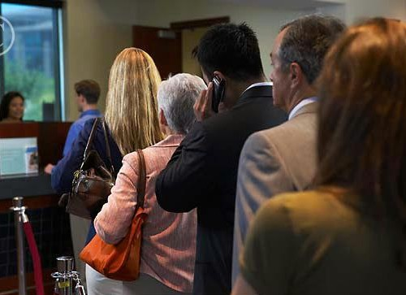
Waiting on the person in front of you.
Notes:
Hector Salamanca in line? Synchronous
Perform something here and now.
I’ll regain control to execute something else when it’s done.

Slide 7

Offloading, Concurrency, Scalability
Resources available
Future-proof

Slide 8

Tip of the Iceberg

Slide 9
Demo: Blocking WPF UI thread

Slide 10
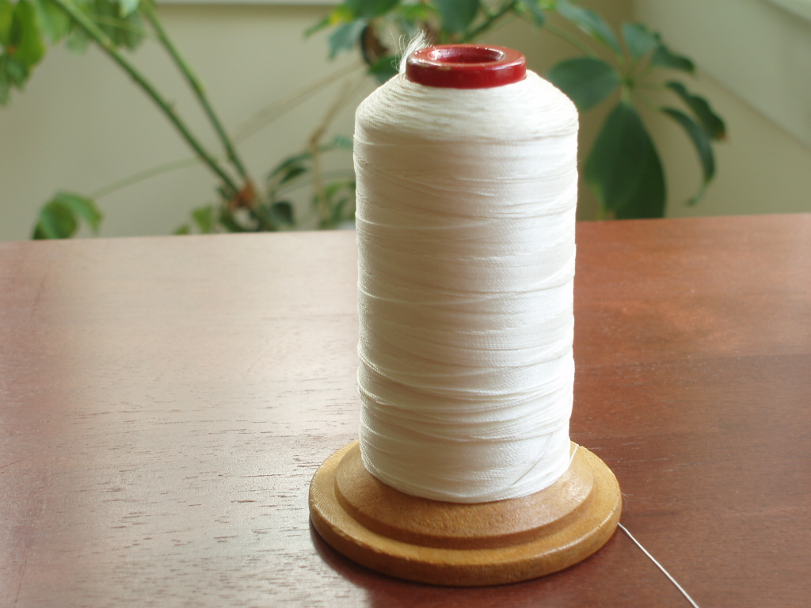
“independently schedulable set of instructions”
Thread Class
Start()

Slide 11

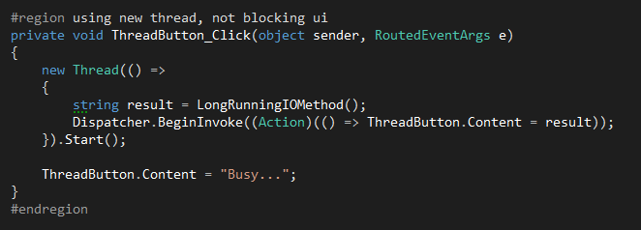

Slide 12
Demo: WPF UI with Thread
Notes:
rubs

Slide 13
UI Responsive
Expensive
Create/Destroy
Thread Context
Notes:
rubs

Slide 14

ThreadPool
Managed
Assign and return
Responsive to demand

Slide 15

ThreadPool == Minions

Slide 16
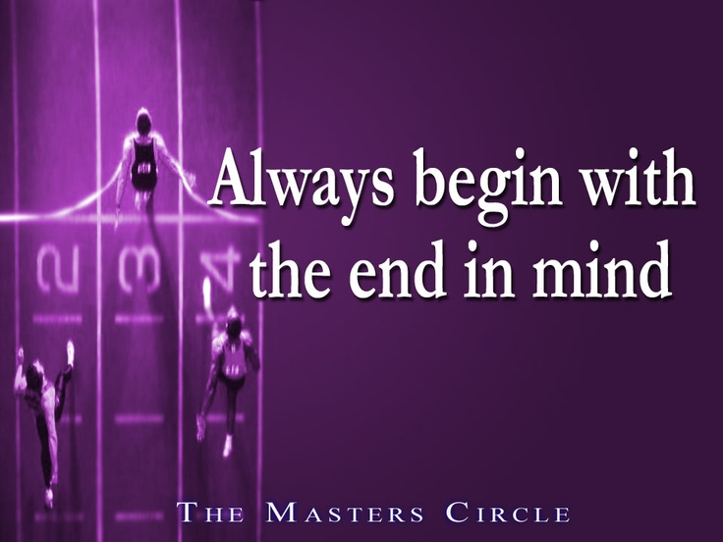
Asynchronous Programming Model (APM)
.NET 1.1
BCL
Begin/End/IAsyncResult
Notes:
Still in use by BCL
Always has Begin___ and End___ methods
Always returns IAsyncResult from Begin____. You need this token to get your results (starbucks)
MUST call End___ to get results, and clean up. End__ may block… and End__ may have Exception for you
So when do I know to call to End___? This is weird eh? Poll, catch fired event, or wait (iscompleted(), asyncwaithandle avoid it, call back (aware of thread UI)
Uncaught exception in End_ kills process
Delegates get APM support for free (but you won’t like it)

Slide 17

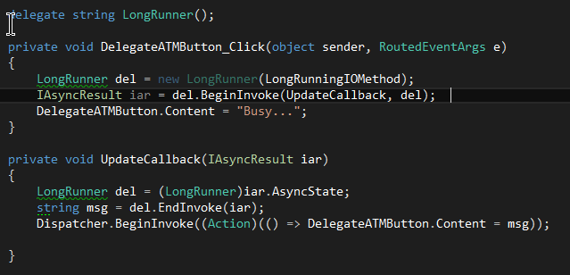

Slide 18
Demo APM

Slide 19
UI Responds
Using ThreadPool

Slide 20
Must call End() / When to End()?
Program flow complex
Thread context
IAsyncResult, AsyncState, ???

Slide 21
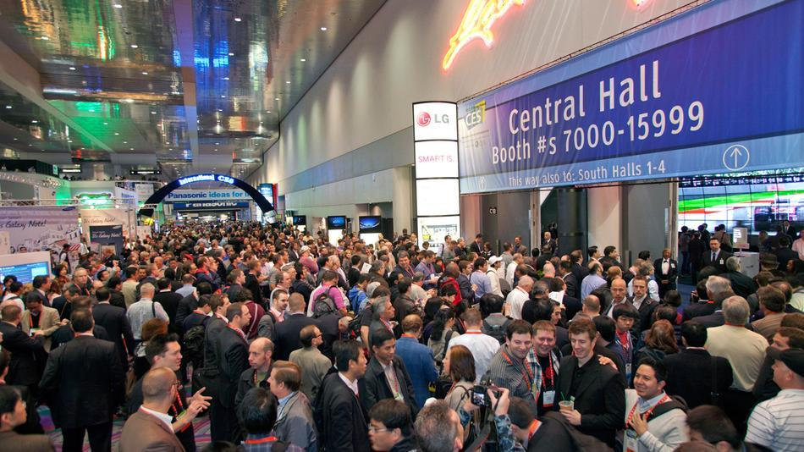
)
Event-based Asynchronous Pattern (EAP)
.NET 2.0
_____Async and _____Completed
No IAsyncResult
Notes:
http://pulseandsignal.com/wp-content/uploads/2013/01/ces-show-floor.jpg
net 2.0 improvement.
2 methods, one to kick off async, and a eventhandler when it’s done
Must wire up eventhandler first, then call the async method….
In mvc3ish, derive from asynccontroller and write xxxAsync and xxxCompleted
Exceptions in mvc…hmmmm. Use a Task to wrap the exception, CompletedArgs in mvc is well….

Slide 22


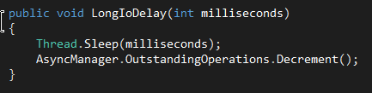
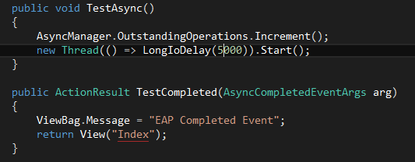
Notes:
Derive from AsyncController
We are supplying the Asyncronous API here in the controller, so we need something to tell us when an async operation is completed. AsynManager does this for us.

Slide 23
Demo: EAP with MVC3

Slide 24
Program flow still complex
AsyncManager
Increment w/o Decrement?

Slide 25
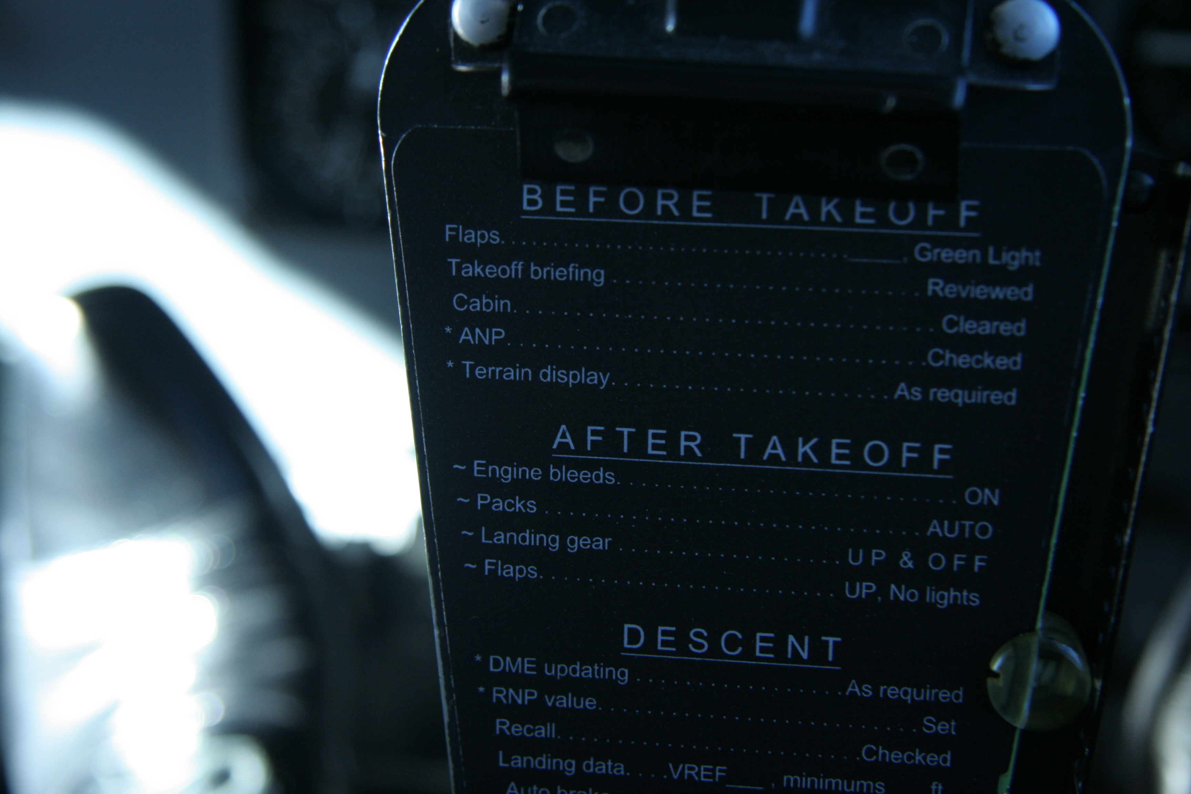
Task, Task<T>
.NET 4.0 / TPL
“Promise” of result
Consistent type

Slide 26

Task.Wait() , Task.Result, Task.WaitAll() block

Slide 27
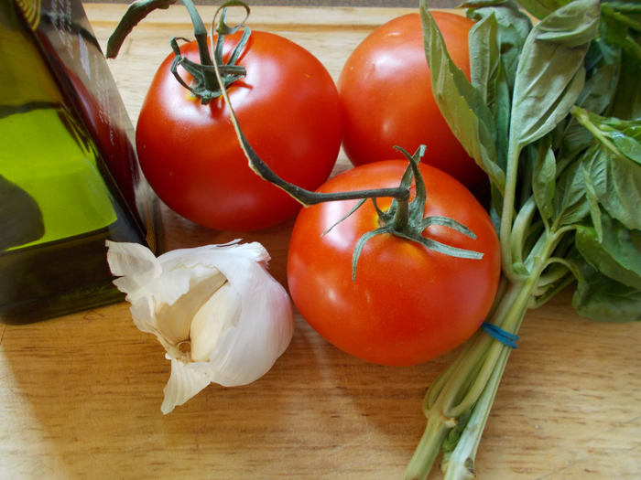
Task-based Asynchronous Pattern (TAP)
.NET 4.5
Simplify using Tasks
async, await

Slide 28
await
Task
async

Slide 29

Make Async look like Sync
Non blocking operations
Unwrap Task<T> types
Notes:
Note increase performance isn’t in this list. Additional overhead is taken on in light of a simpler programming api.

Slide 30
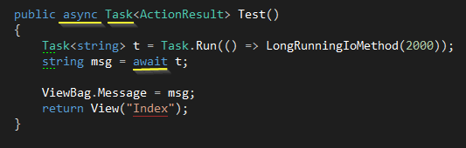
Notes:
2 line await is easier to read

Slide 31
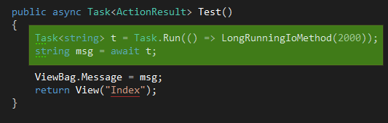
Notes:
Code cut in to 2 parts, top part actually run’s synchronously until it hits the await.
Explain the string being extracted from the Task

Slide 32
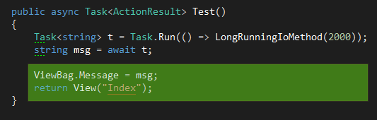
Notes:
This is called the continuation. When the code gets back here, the local variables are restored, and the thread context is restored.

Slide 33
Demo MVC4 Async Await
Notes:
Demo mvc4 async await

Slide 34
async notifies compiler that await is coming
await is where the method’s continuation is created. Chopped in 2
Think of awaiting types, not methods returning
Thread context is restored
Task<T> automatically unwrapped for T
Task, Task<T> or Void to use await

Slide 35
Blocking operations
Threads / ThreadPool
Thread Context
APM via delegate
EAP
Task / TAP / async await

Slide 36
Async await code looks like sync code
Feet can still be shot
Shared resources still require synchronization
async await propagates
Overhead added

Slide 37
@lwischik Lucian Wishik
@Stephen_Cleary
Stephen Toub http://blogs.msdn.com/b/pfxteam/

Slide 38
Questions?

Slide 39
THANK YOU!

